Slide 1
Welcome to Stat 240!
Spring 2024
Instructor: Sahifa Siddiqua

Slide 2
About Your Instructor

Slide 3
Sahifa Siddiqua (Call me Ms. Sidd!)
BSc in Mathematics from India
MS and PhD in Mathematical Statistics from the University of Mississippi
Joined UW-Madison last Fall.
STAT 240, Spring 2025, Lecture 1

Slide 4
My Promises As Your Instructor
Homework and exams will faithfully reflect lecture content
Expectations, deadlines, and grading criteria will be clearly communicated and applied fairly and strictly!
We will foster an inclusive learning environment for everyone
We will be responsive, understanding, and accommodating to individual needs and life situations
There is no such thing as a stupid question!
STAT 240, Spring 2025, Lecture 1

Slide 5
The Big Question
What are you going to learn in this class?

Slide 6



Why This Course Matters…
The goal of this class is to equip you to investigate real world questions using data.
Translating broad, unclear, plain language questions into rigorous, testable, numeric ones
Manipulating messy data, thinking critically about what conclusions we can and cannot make from that data
Presenting those conclusions in a way that makes sense to non-experts as well as experts
STAT 240, Spring 2025, Lecture 1

Slide 7


…Even if You’re Not a Data Scientist
These principles are universal, even if you won’t be coding or doing statistical analysis in your career
Learn with an open mind… you might surprise yourself!
STAT 240, Spring 2025, Lecture 1

Slide 8
The Big Picture
How exactly does STAT 240 work?

Slide 9
Course Flow: Big Picture
First 5ish weeks of semester: Crash Course on R/tidyverse
Ends with an in-class exam (“Midterm 1”) on R/tidyverse
Next 5ish weeks of semester: Probability & Random Variables
Ends with in-class exam (“Midterm 2”) on probability/random variables (may include some R concepts from part 1)
Final 5ish weeks of semester: Statistical Inference, Modeling Real Dataset Exploration/Inference
Final Exam is in-person, cumulative
STAT 240, Spring 2025, Lecture 1

Slide 10
Course Flow: Week to Week
The Canvas home page is your number one resource for all course-related information
Three lectures per week on course content, same room, same time, conceptual units roughly spanning one week. Lectures are highly recommended!!
The following week, Monday, Tuesday, or Wednesday: in discussion, low-stakes review of previous week with peers, graded on being there and participating (bring your laptop)
Discussions are mandatory!!
Friday after discussion: individual weekly homework due at 11:59pm, graded for accuracy and correctness
STAT 240, Spring 2025, Lecture 1

Slide 11
Lectures
Lectures will be recorded, and videos will be posted to Canvas weekly on Kaltura Gallery (not every day)!!
Bring your laptops!! Lectures will frequently include live coding activities/checks of understanding, with opportunities to ask questions and interact with your instructor.
Homework and discussion assignments will assume that you are up to date on lecture material.
STAT 240, Spring 2025, Lecture 1

Slide 12
Grading
Your overall score is comprised of these weighted categories:
Discussion Participation (2 free drops): 10%
Weekly Homeworks (1 free drop): 20%
Group Project: 10%
Midterm 1: 20%
Midterm 2: 20%
Final Exam: 20%
STAT 240, Spring 2025, Lecture 1
Notes:
Can straight up read this one

Slide 13
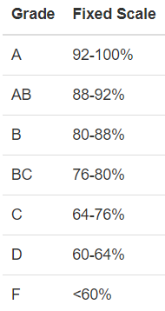
Grading
Your letter grade will be evaluated based on this scale.
No curve!!
STAT 240, Spring 2025, Lecture 1
Notes:
Can straight up read this one

Slide 14
Resources
Asynchronous Help | In-Person Help
Coursewide Piazza | Student Hours*
Email Professor and/or your TA | Statistics Learning Center
* Also known as “office hours”
STAT 240, Spring 2025, Lecture 1

Slide 15
Expectations from students
Students are expected to be regular in lectures and discussions and participate actively.
Students are expected to be up-to-date with the course materials and on time with their HW submissions and discussions. No excuse will be accepted for missing HW and discussions except for the ones discussed/shared in advance with me or the TAs.
Each one of you is expected to collaborate with your group members for discussion assignments and group projects. Failure to do so will result in 0 for your assignments.
Students need to bring it to our (mine and the TAs) notice if they are having trouble with the course material, software issues, or classmate issues.

Slide 16
Installing R and RStudio
On Your Individual Device

Slide 17
Installing R and RStudio
Leave directories and settings as default unless you know what you’re doing!
https://posit.co/download/rstudio-desktop/
First, click “Download and Install R”. Click “Download R for macOS” or “Download R for Windows” depending on what type of computer you have, in the top box.
MacOS: Click the .pkg file that applies to your computer
Windows: Click “Install R for the first time”, and then “Download R-4.3.2 for Windows”
Then, back at the above link, click “Download Rstudio Desktop”, which will just give you a file.
STAT 240, Spring 2025, Lecture 1

Slide 18
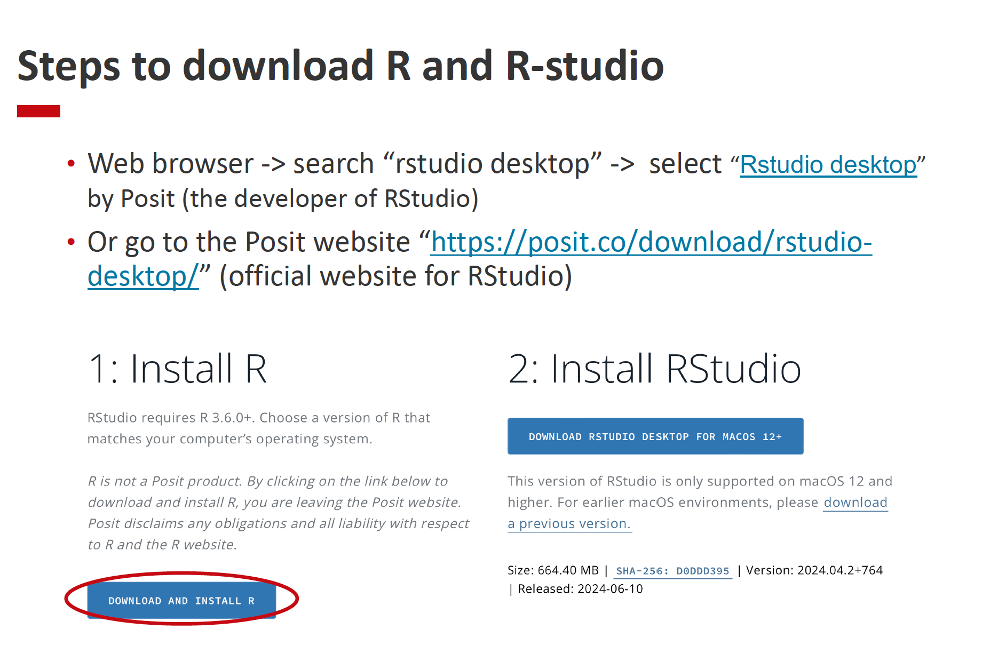
STAT 240, Spring 2025, Lecture 1

Slide 19
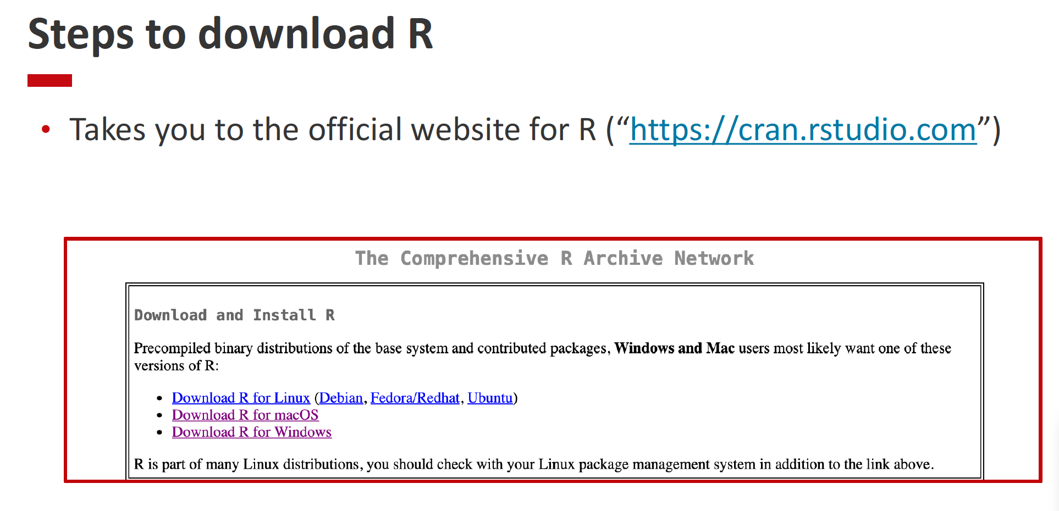
STAT 240, Spring 2025, Lecture 1

Slide 20
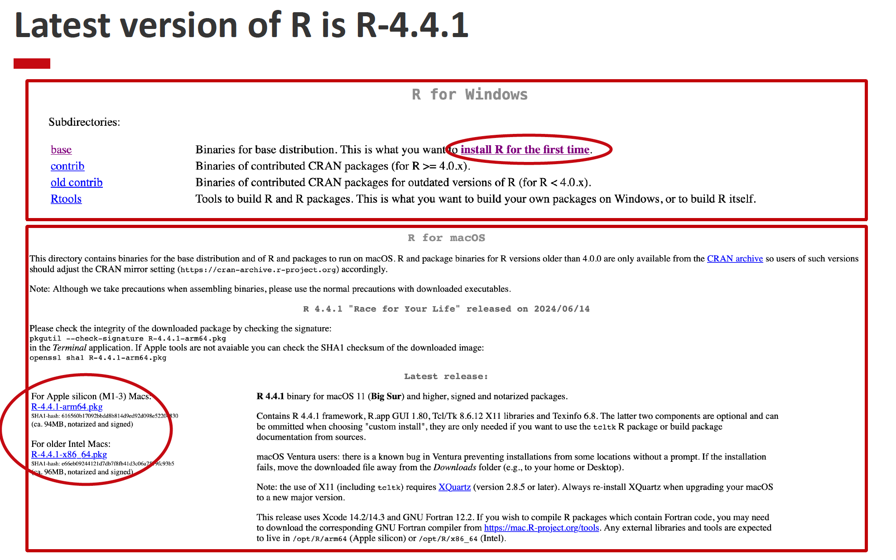
STAT 240, Spring 2025, Lecture 1

Slide 21
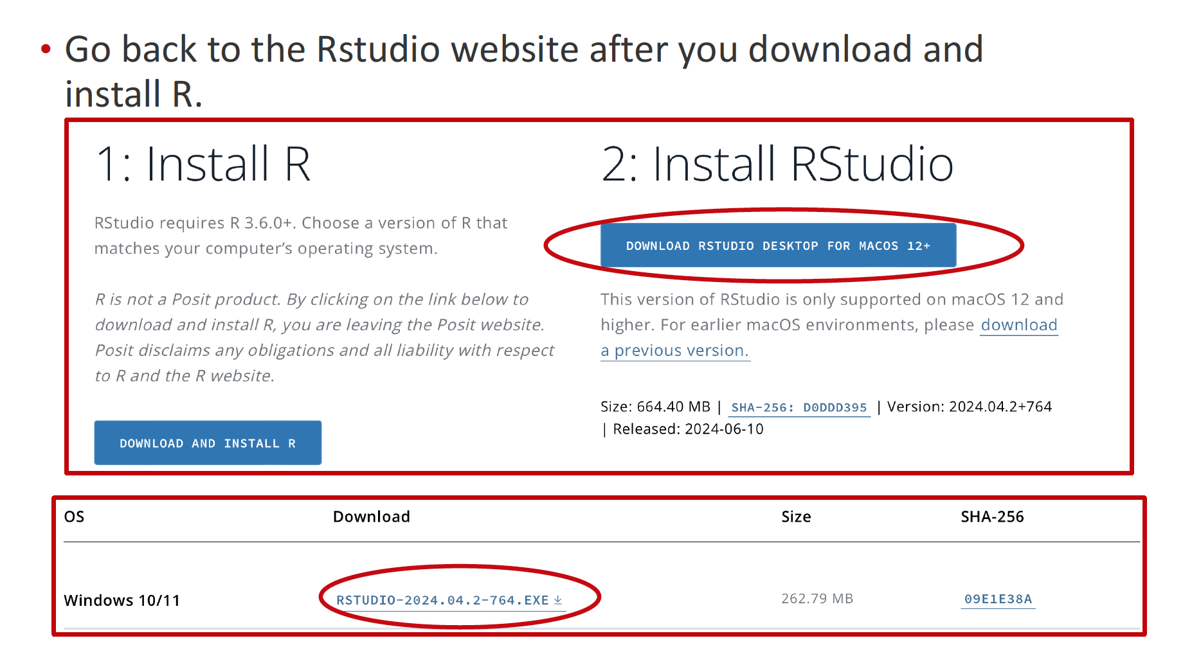
STAT 240, Spring 2025, Lecture 1

